Slide 1
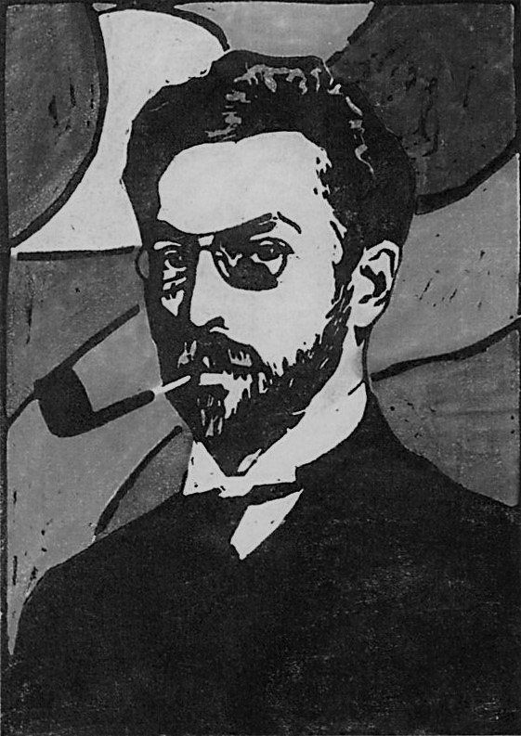
GANdinsky
Course: Neural Networks & Deep Learning
Instructor: Dr. Farid Alizadeh
Group Members: Elnaz A. Torkamani, Ruiwen Zhang, Sunit Nair

Slide 2
Contents
1
Introduction
Project scope and limitations
2
Generative Adversarial Networks
Concept and overview
3
Project Architecture
Architecture, Libraries, and Tools used
4
Results
Generated Images and Future Work
5
References and Conclusion
Datasets, GitHub etc.

Slide 3
1: Introduction
Project scope and limitations
Project scope
Create a Generative Adversarial Network to create art from portrait and abstract datasets.
Set up project to read data from Google Drive and save output to Google Drive.
Compress raw dataset into readable and reusable files.
Extended scope: explore additional types of GAN (WGAN)
Limitations
Objective evaluation of model is difficult compared to classification/regression problems.
Good results require large number of epochs and/or complex modeling.
Long session running times and limitations on hardware availability (Colab Pro).
Subjective nature and interpretation of “art” (more about this in the next slide)
Definition of art
For the purpose of this project, any image generated that resembles the style of the dataset to a recognizable degree without introducing overfitted elements or blatant patterns is considered generated art.

Slide 4

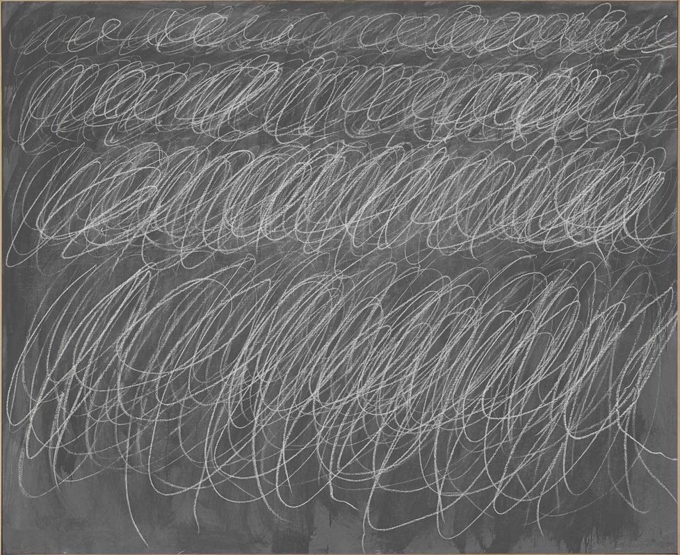
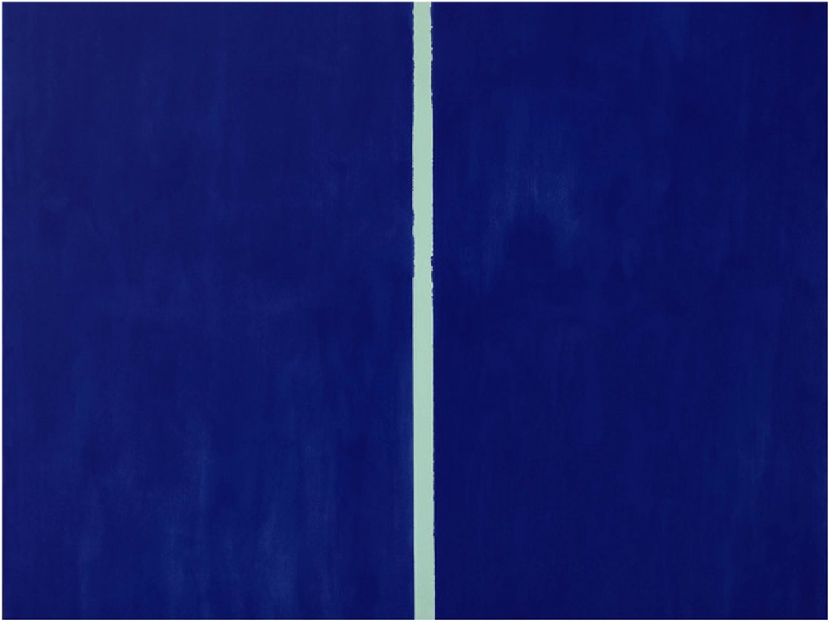
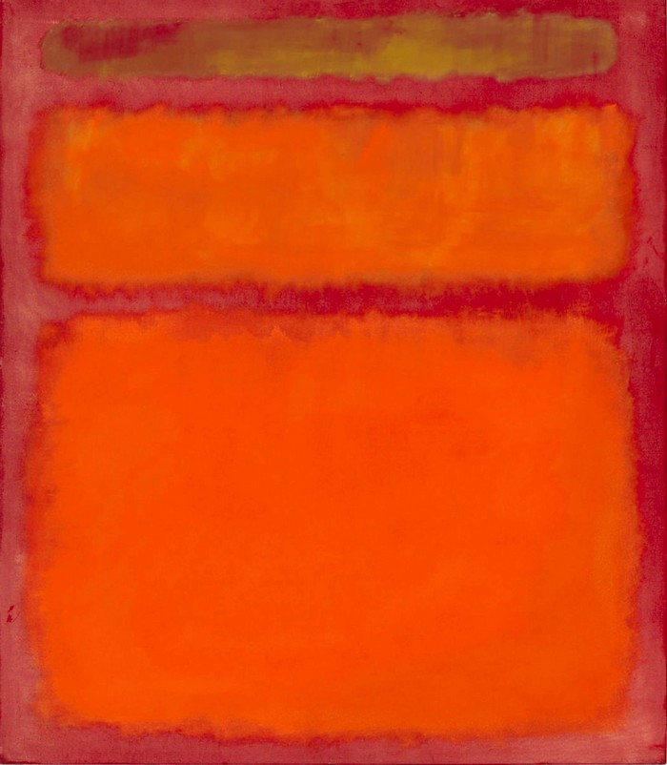
1: Introduction
Subjective nature of art
The blood-red mirror
by Gerhard Richter
$1.1 million
Untitled
by Cy Twombly
$2.3 million
Onement VI
by Barnett Newman
$43.84 million
Orange, Red, Yellow
by Mark Rothko
$86 million
Another reason for this might be the controversial status quo of the “art world” as explained in this video.
Source: iloboyou.com

Slide 5
2: Generative Adversarial Networks
Concepts and overview
Definition
Generative Adversarial Networks (GANs) are algorithmic architectures that use two neural networks, pitting against the other (thus the “adversarial”) in order to generate new, synthetic instances of data that can pass for real data.
History
GANs were introduced in a paper by Ian Goodfellow and other researchers at the University of Montreal, including Yoshua Bengio, in 2014.
Applications
Widely used in the generation of images, video, and voice.
Some types of GANs
Deep Convolutional GANs (DCGANs)
Conditional GANs (cGANs)
StackGANs
InfoGANs
Wasserstein GANs (WGANs)

Slide 6
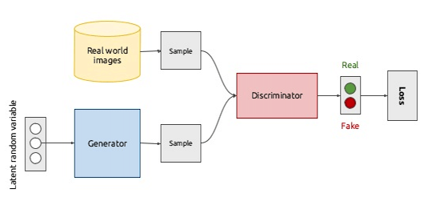
2: Generative Adversarial Networks
Generative vs Discriminative Networks
Source: mc.ai
Discriminative Network
Tries to classify input data. Given the features of an instance of data, predict a label or category to which it belongs. In this instance, differentiate between a real and fake painting.
Generative Network
Attempt to predict features given a certain label or category to which that data belongs.
These opposing objectives and competition between the two networks is the hallmark of GANs.

Slide 7
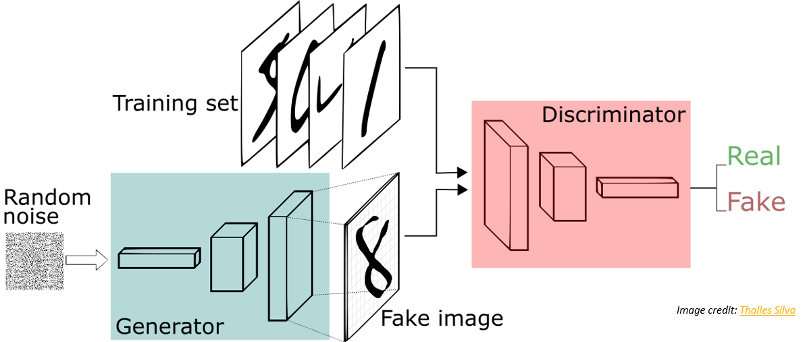
2: Generative Adversarial Networks
How GANs work
Source: medium.com
How GANs work
The generator generates and returns an image
The generated image is fed into the discriminator alongside a stream of images taken from the actual dataset
The discriminator takes in both real and fake images and returns probabilities

Slide 8
3: Project Architecture
Architecture, Libraries, and Tools used
Python Libraries Used
Keras, numpy, Pillow (PIL), google.colab, time, os
Platforms/IDEs used
Google Colaboratory
Spyder
Input
Images resized to 128 x 128, and compressed into a single .npy file
Output
Generated images in a configurable grid
Model state/weights in .h5 files
Configurable Parameters
No. of images to preview/save, number of epochs after which to save previews, noise size, batch size, generated resolution, image size, continue training

Slide 9
3: Project Architecture
Architecture, Libraries, and Tools used
GAN Model: DCGAN (Deep Convolutional Generative Adversarial Networks)
Discriminator
Model: Sequential
Activation: LeakyRelU(alpha=0.2)
Last Layer Activation: Sigmoid
Generator
Model: Sequential
Activation: RelU
Last Layer Activation: tanh
Optimizer
Adam:
Learning Rate: 0.00015
Beta: 0.5
Loss/Metrics
Binary cross-entropy
Accuracy

Slide 10
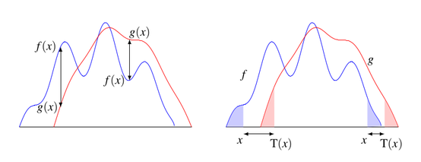
3: Project Architecture (Aside)
Experiments with WGAN
Mathematical understanding
Wasserstein or Kantorovich–Rubinstein metric or distance is a distance function defined between probability distributions on a given metric space M.
Consider two functions f and g. Usual distances inevitable measure distance (difference) between f(x) and g(x) i.e. along the y-axis for certain values of x or use maximums/averages.
However, if f and g are similarly distributed but only translated linearly along x-axis, these distances may differ vastly.
Also, traditional distances fail to measure the similarity between the functions that is lost due to the translation.
Wasserstein distances attempt to capture these similarities.
Source: Optimal Transport for Applied Mathematicians, by F. Santambrogio

Slide 11
3: Project Architecture (Aside)
Experiments with WGAN
Intuitive Understanding
A special way to compare probability distributions.
Earth-mover problem.
In the context of GANs
A meaningful loss metric that correlates with the generator’s convergence and sample quality.
Improved stability of the optimization process.
Intuitively, convert the discriminator network from a forgery expert into an art critic.
Results with WGANs
Shows improved convergence in LSUN and MNIST datasets (max 64 x 64).
Mixed results and convergence issues with other datasets (CelebA).
Failed to converge with our datasets from WikiArt (128 x 128 portrait/abstract datasets).
Converting DCGAN to WGAN
Ensure last layer of Discriminator is linear (not sigmoid).
Add a clipper constraint to discriminator layers.
Train discriminator (5x) more than generator.
Optimizer: RMSProp
Loss function: Wasserstein Loss (mean(sum(y_true * y_pred))

Slide 12
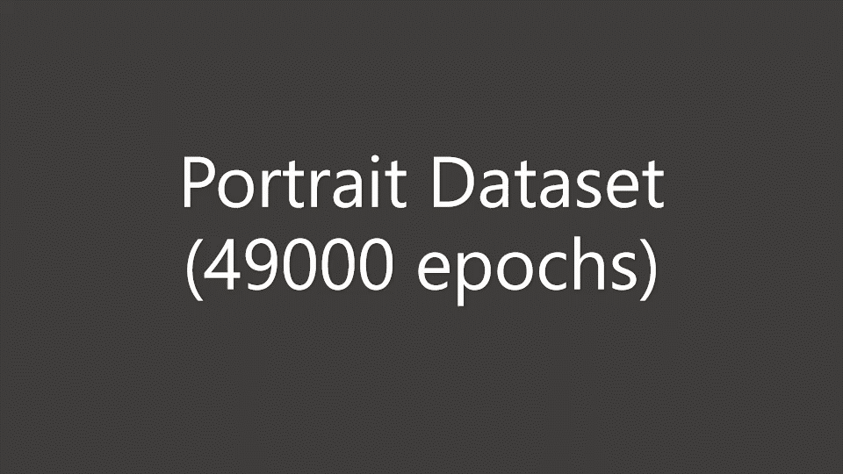
4: Results
Model progress visualization: Portrait dataset (6000 images)

Slide 13
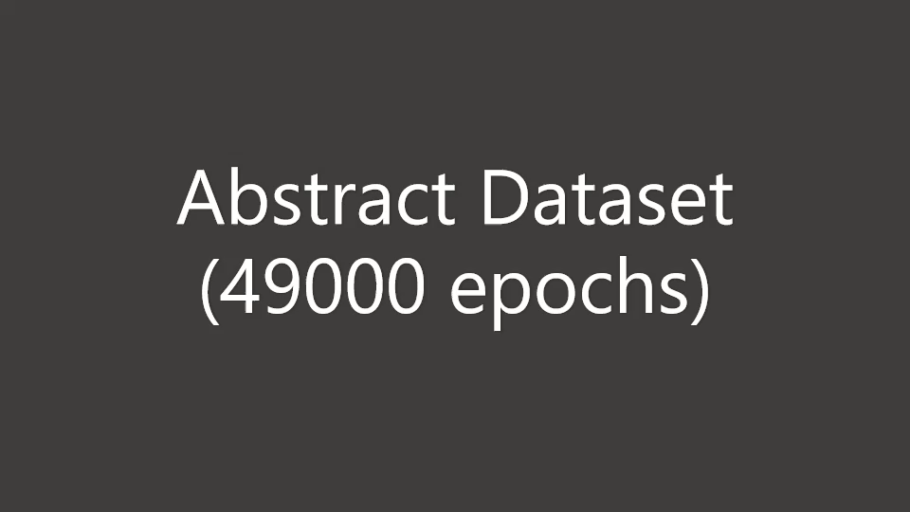
4: Results
Model progress visualization: Abstract dataset (6383 images)

Slide 14
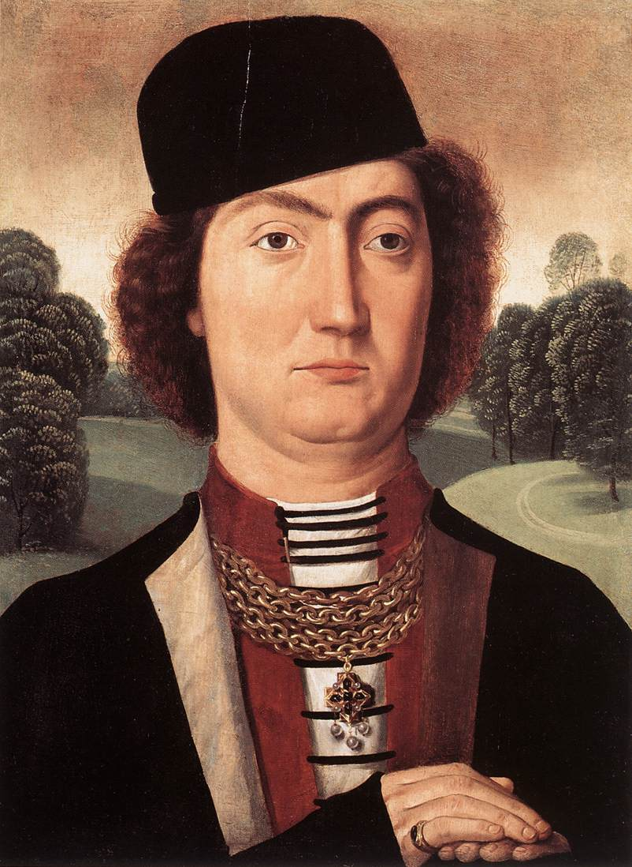
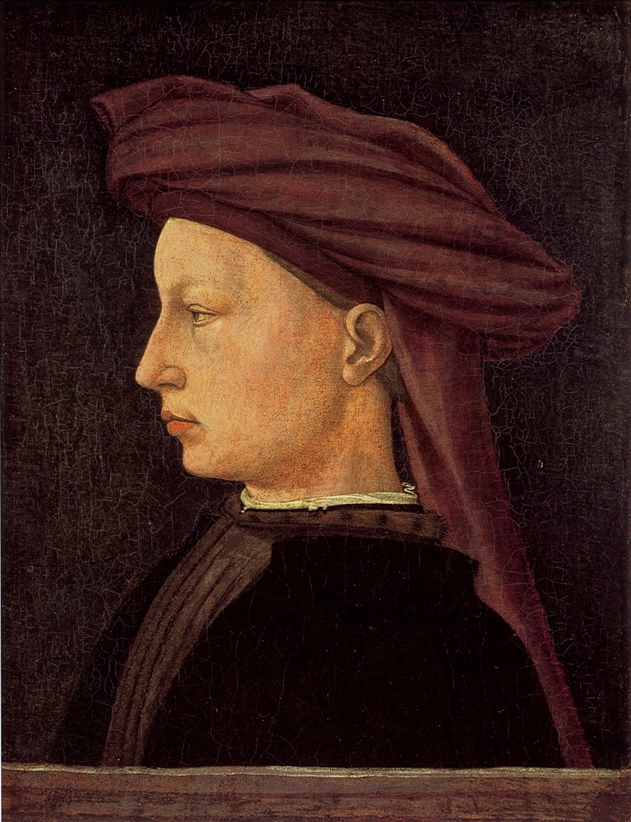
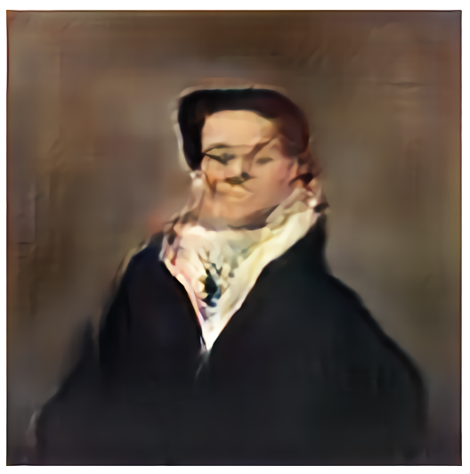
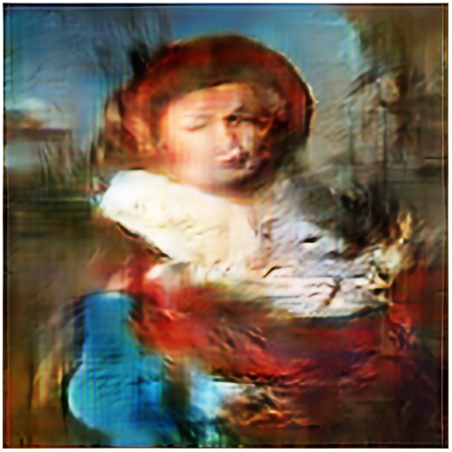
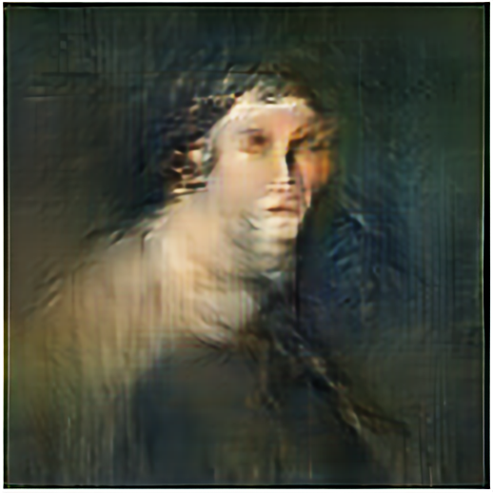
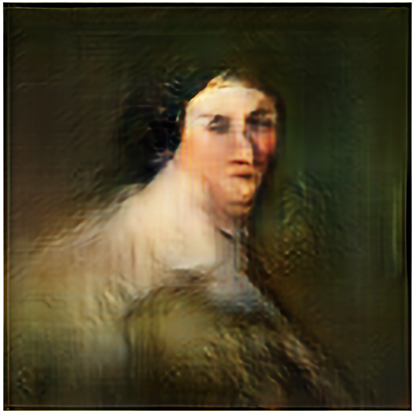
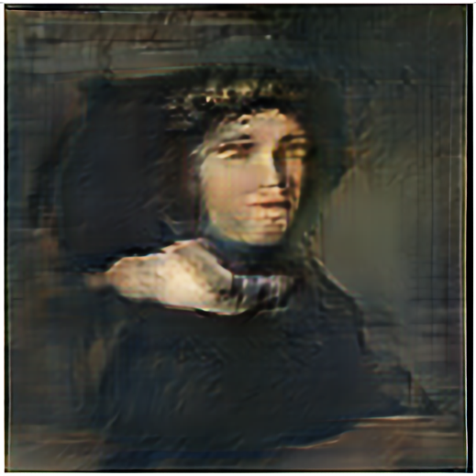
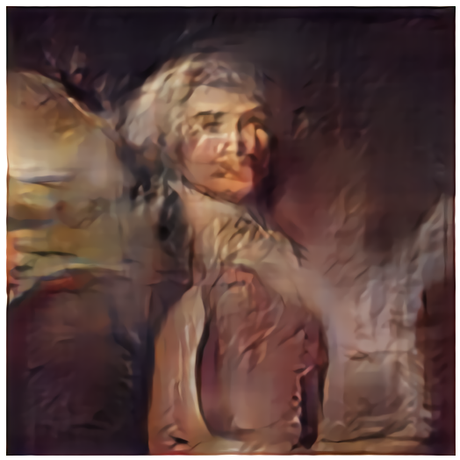
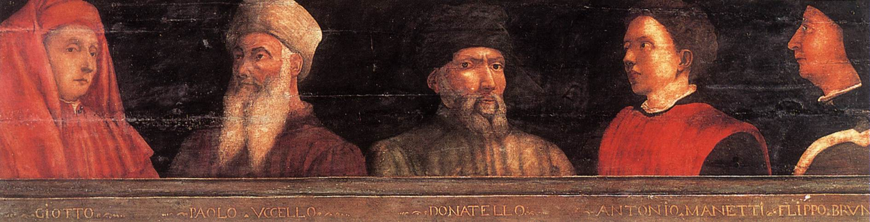
4: Results
Portrait dataset vs generated images
Sample images from dataset (input)
Sample images from results (output)

Slide 15
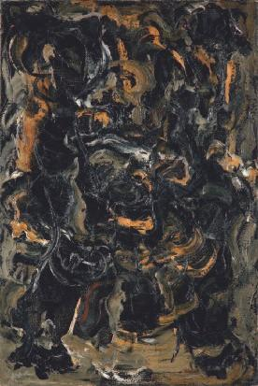
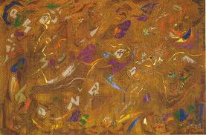
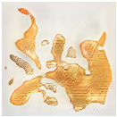
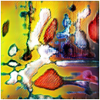
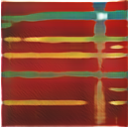
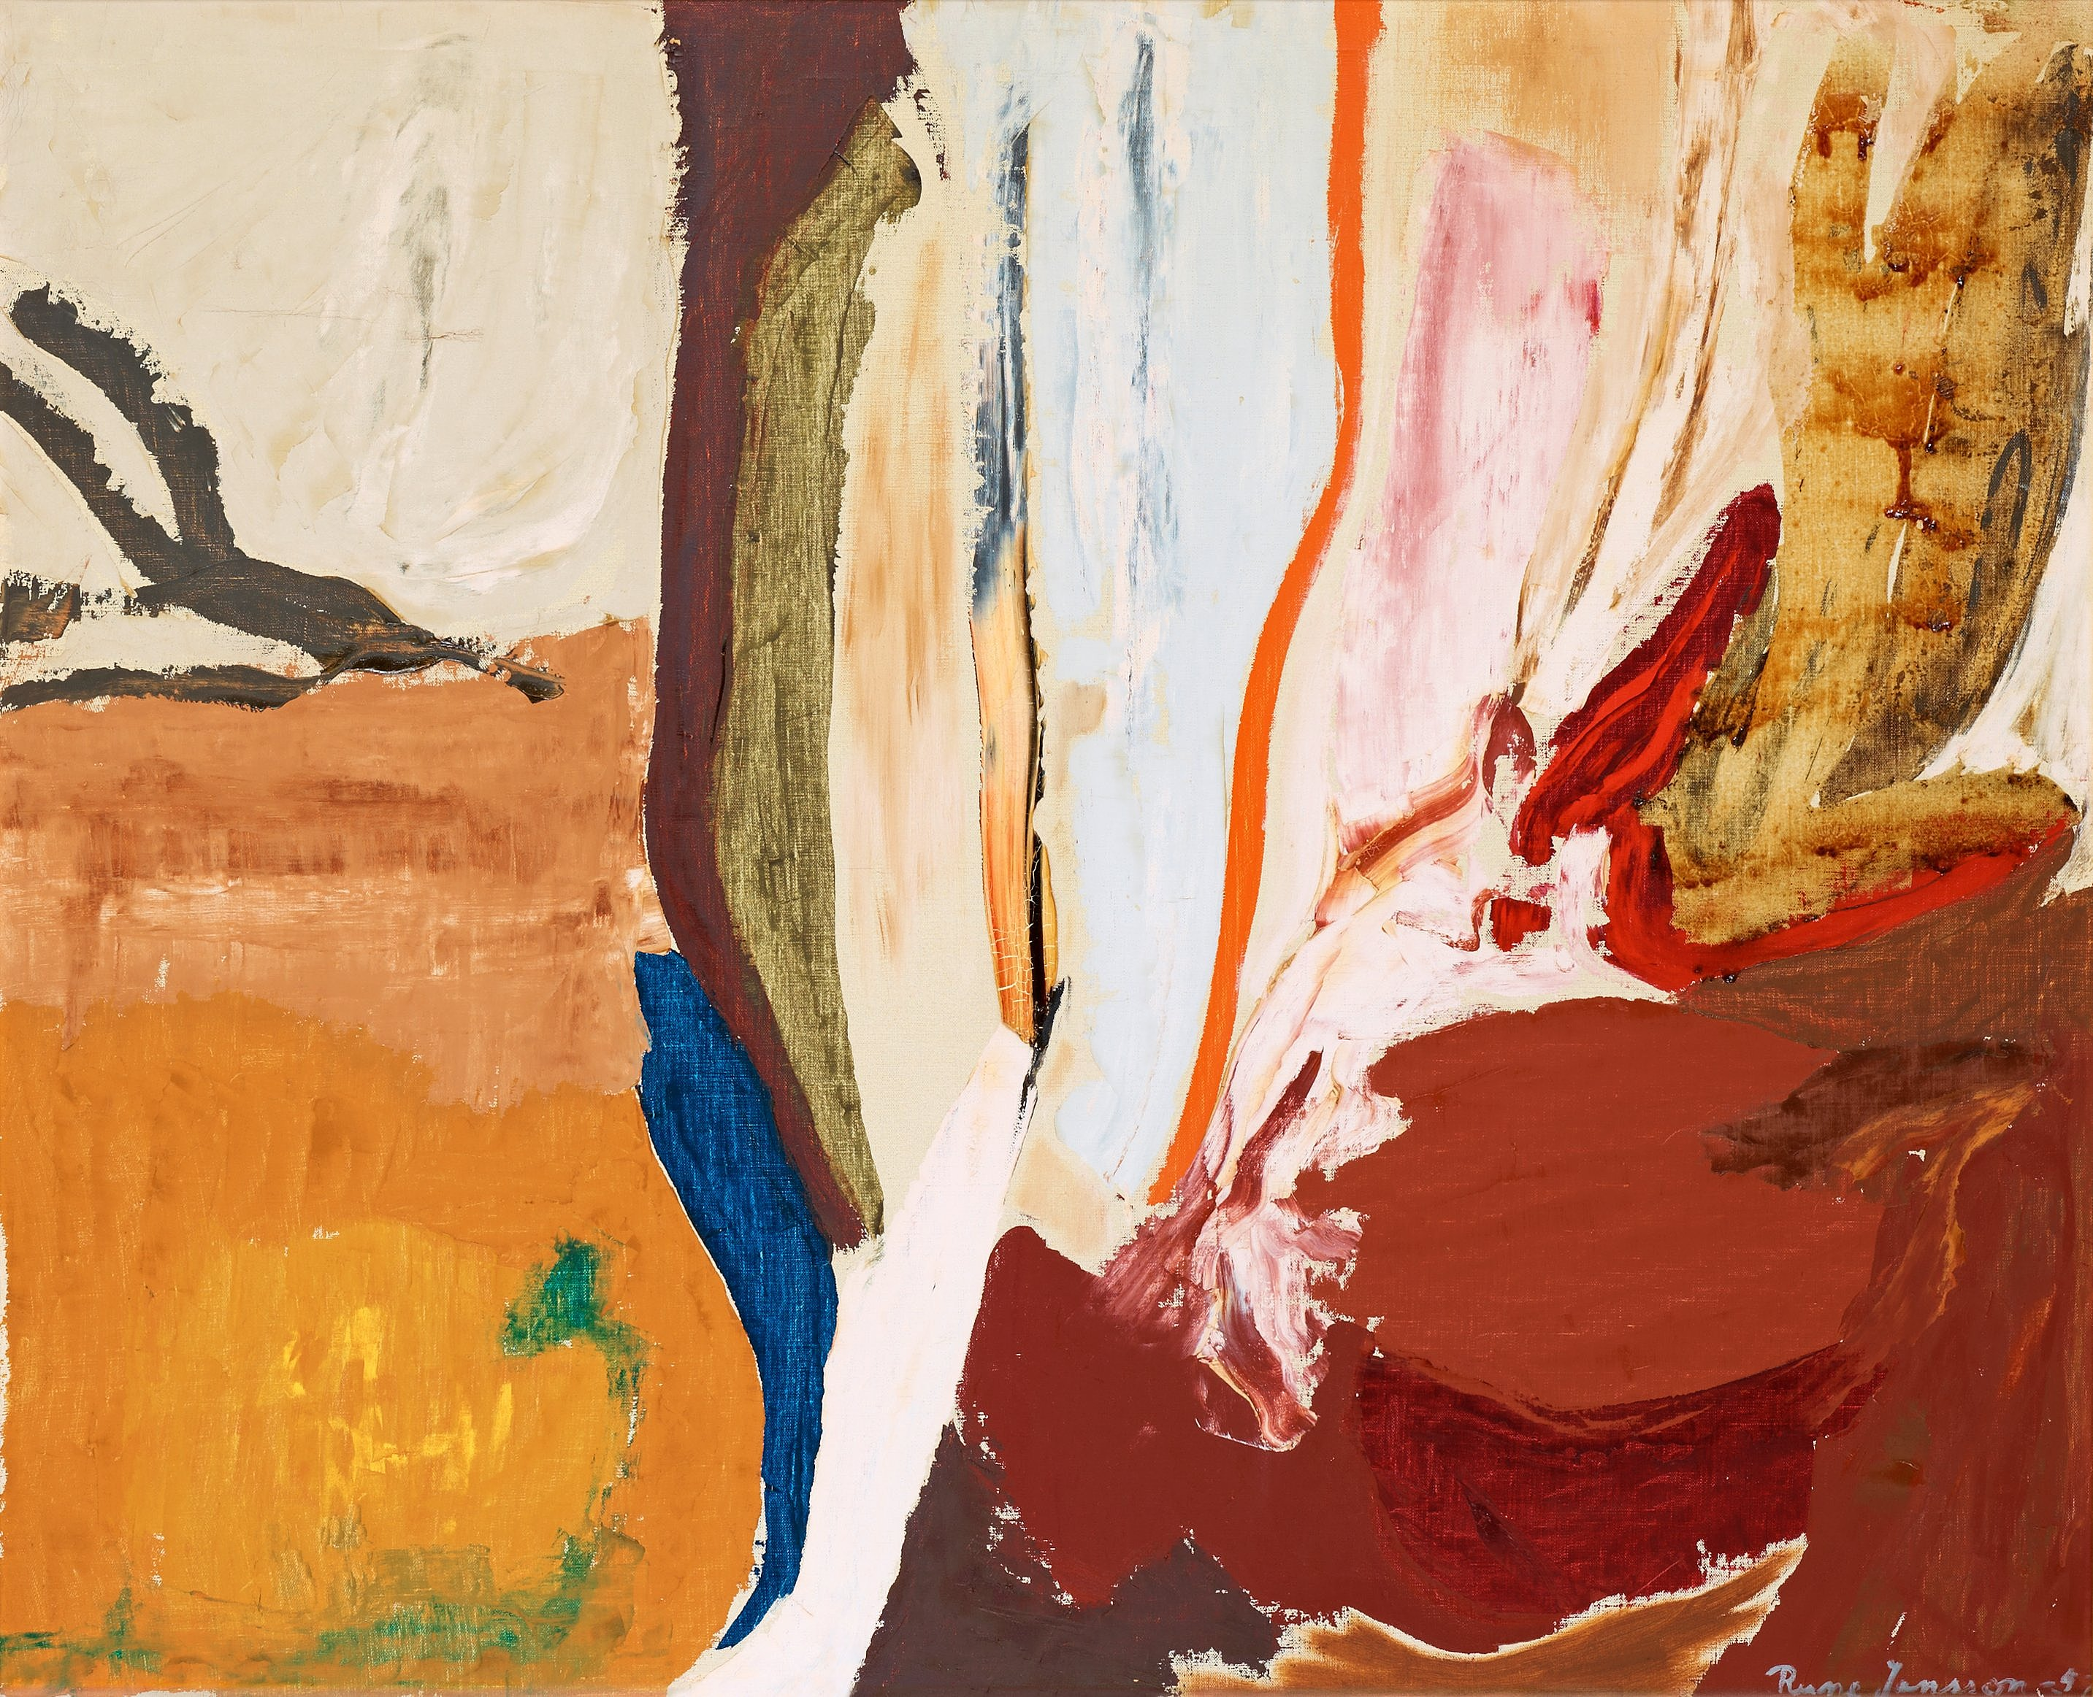
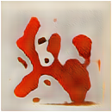
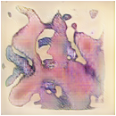
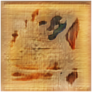
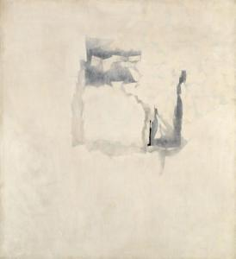
4: Results
Abstract dataset vs generated images
Sample images from dataset (input)
Sample images from results (output)

Slide 16
5: References
Datasets, Repositories, and References
Datasets
WikiArt.org
Repository on Google Drive sourced from GitHub
Repositories
GitHub: nndl-groupc/gandinsky
GANdinsky Public Repository: Google Drive
Online Resources Used
https://towardsdatascience.com/
https://heartbeat.fritz.ai/
https://medium.com/
Wasserstein GAN Research Paper
https://arxiv.org/pdf/1701.07875.pdf

Slide 17
5: Conclusions
Future work and potential
Project features and limits
GANdinsky was developed and tested on Colab (free).
Maximum epochs were run on Colab Pro account (97000 epochs in 24 hours).
Relatively new (2014) WGAN model doesn’t work well with the chosen dataset.
Saved models can be used to continue training.
Possible refinements/Future work
Implement WGAN or other better discriminator/generator models.
Lease hardware (Amazon EC2) to run more epochs.
Use larger datasets (9000+ images).
Larger inputs and output resolutions (256 x 256).
Potential
AI art sold for $432,500.
A trend is emerging with AI generated content being sold as art.
GANs and their creative applications have expanded the applications of AI from problem solving to creativity and artistic areas.
The potential for such models is still being discovered: games, security, entertainment.

Slide 18
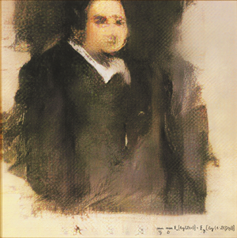
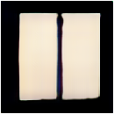
5: Conclusions
Comparing GANdinsky to AI generated and human art
Edmond de Belamy
by French art collective Obvious (AI generated)
$432,500
Onement VI
by Barnett Newman
$43.84 million
portrait_epoch_46000[0,1]
by GANdinsky
abstract_epoch_19000[2,6]
by GANdinsky

Slide 19
Thank You!

